Slide 1
Preemptive Scheduling of a Single Machine to Minimize Maximum Cost Subject to Release Dates and Precedence Constraints
K.R. Baker, E.L. Lawler, J.K. Lenstra, A.H.G. Rinnooy Kan
Operations Research 1983

Slide 2
Agenda
Main Problem
Equal Release Dates
Arbitrary Release Dates, No Precedence Constraints
Arbitrary Release Dates, Arbitrary Precedence Constraints
Numerical Example

Slide 3
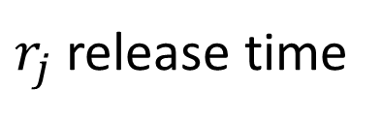


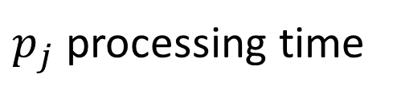
Main Problem
$n$ jobs are to be processed on a single machine
$j→k$ precedence constraint, job $j$ must finish before $k$ starts
For job $j$:
$p_{j}$ processing time
$r_{j}$ release time
$f_{j}\left(C_{j}\right)$ monotonic nondecreasing cost function for the completion time
Find a feasible schedule that minimizes $\max_{j}\left\{f_{j}\left(C_{j}\right)\right\}$
Unlimited preemptions allowed
(nonpreemptive case is NP-hard even without precedence constraints)

Slide 4


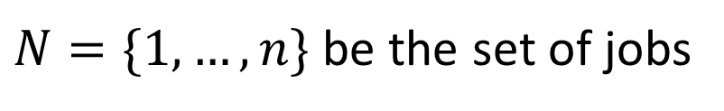
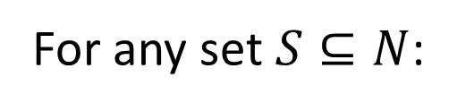
Equal Release Dates
$N=\{1,…, n\}$ be the set of jobs
For any set $S⊆N$:
$p\left(S\right)=\sum_{j∈S}{p_{j}}$ be the total processing time of the set
$N′⊆N$ be the set of jobs without successors
Let job $l∈N′$ be such that $f_{l}\left(p\left(N\right)\right)=\min_{j∈N^{′}}\left\{f_{j}\left(p\left(N\right)\right)\right\}$
($l$ is an available job who has the smallest cost if placed at end of schedule)
Algorithm:
Find job $l$ and place it at the end of the schedule
Remove $l$ from $N$ and its associated precedence constraints
Repeat, scheduling from last to first

Slide 5


Arbitrary Release Dates, No Precedence Constraints
With preemption, it is never advantageous to leave the machine idle if there are available jobs.
Scheduling jobs in order of nondecreasing release times $r_{j}$ to form blocks.
Block $B⊆N$ is a minimal set of jobs processed without idle time.
Start time of block $B=$ $r\left(B\right)=\min_{j∈B}\left\{r_{j}\right\}$
Completion time of block $B=$ $t\left(B\right)=r\left(B\right)+p(B)$
Let job $l∈B$ be such that $f_{l}\left(t\left(B\right)\right)=\min_{j∈B}\left\{f_{j}\left(t\left(B\right)\right)\right\}$
Job $l$ is processed only if no other job is available.
$B−\{l\}$ decomposes into $b$ subblocks: $B_{1},…,B_{b}$
$l$ was the “glue” holding the subblocks together so the schedule of $l$ is:
$\left[r\left(B\right),t\left(B\right)\right]−∪_{i=1}^{b} [r\left(B_{i}\right),t\left(B_{i}\right)]$ and job $l$ is completed at $t\left(B\right)$
(Preemption is essential to determine the optimal block structure in advance)

Slide 6
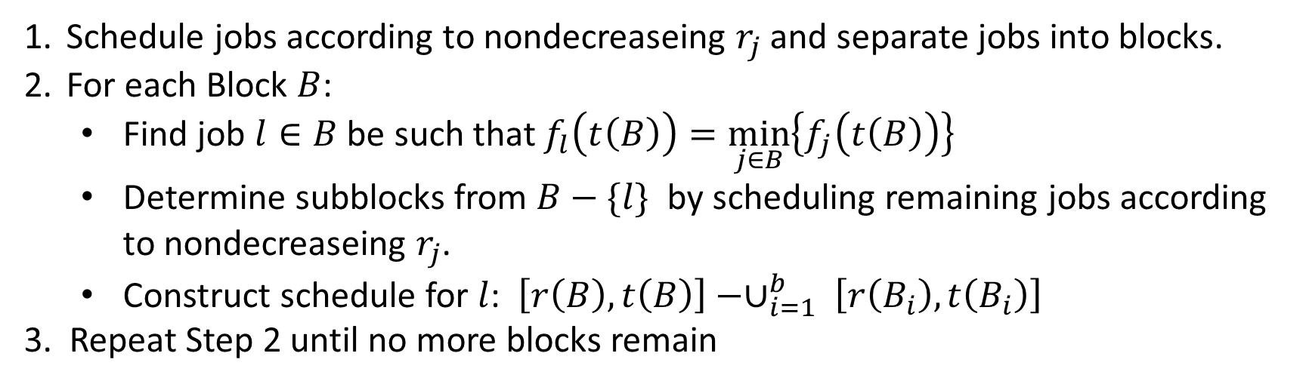
Arbitrary Release Dates, No Precedence Constraints
Algorithm:
Schedule jobs according to nondecreaseing $r_{j}$ and separate jobs into blocks.
For each Block $B$:
Find job $l∈B$ be such that $f_{l}\left(t\left(B\right)\right)=\min_{j∈B}\left\{f_{j}\left(t\left(B\right)\right)\right\}$
Determine subblocks from $B−\{l\}$ by scheduling remaining jobs according to nondecreaseing $r_{j}$.
Construct schedule for $l$: $\left[r\left(B\right),t\left(B\right)\right]−∪_{i=1}^{b} \left[r\left(B_{i}\right),t\left(B_{i}\right)\right]$
3. Repeat Step 2 until no more blocks remain

Slide 7
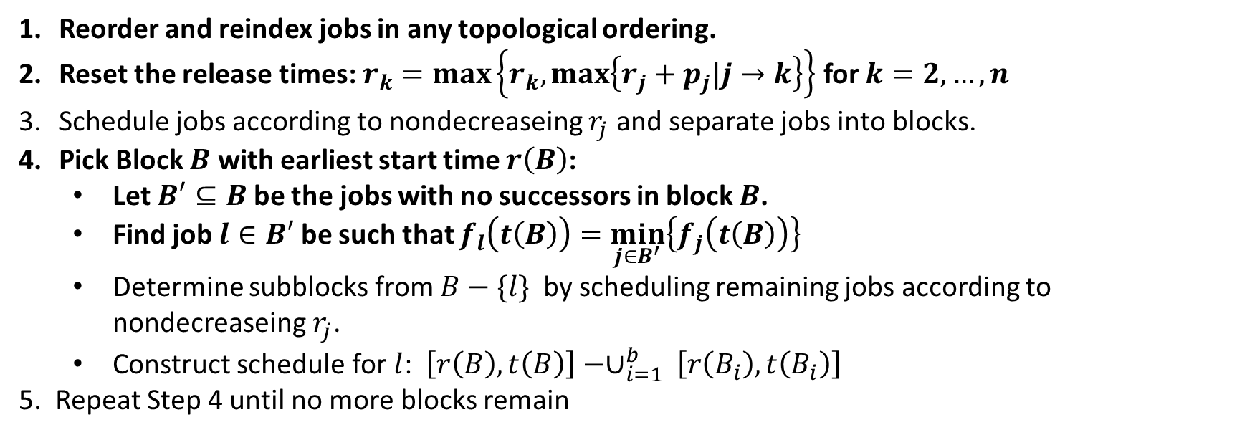
Arbitrary Release Dates, Arbitrary Precedence Constraints
Similar to no precedence constraints with some added and changed steps.
Reorder and reindex jobs in any topological ordering.
Reset the release times: $r_{k}=\max_{}\left\{r_{k},\max_{}\left\{r_{j}+p_{j}|j→k\right\}\right\}$ for $k=2,…,n$
Schedule jobs according to nondecreaseing $r_{j}$ and separate jobs into blocks.
Pick Block $B$ with earliest start time $r\left(B\right)$:
Let $B′⊆B$ be the jobs with no successors in block $B$.
Find job $l∈B′$ be such that $f_{l}\left(t\left(B\right)\right)=\min_{j∈B^{′}}\left\{f_{j}\left(t\left(B\right)\right)\right\}$
Determine subblocks from $B−\{l\}$ by scheduling remaining jobs according to nondecreaseing $r_{j}$.
Construct schedule for $l$: $\left[r\left(B\right),t\left(B\right)\right]−∪_{i=1}^{b} \left[r\left(B_{i}\right),t\left(B_{i}\right)\right]$
5. Repeat Step 4 until no more blocks remain

Slide 8







Numerical Example
$$B_{1}=\{1,2,3,4\}$$
$$B_{2}=\{5\}$$
$$B_{1}′=\{3,4\}$$
$$f_{3}\left(12\right)<f_{4}\left(12\right)$$
$$B_{11}=\{1,2\}$$
$$B_{12}=\{4\}$$
$$f_{1}\left(6\right)<f_{2}\left(6\right)$$

